Slide 1
Hi-COVIDNet Deep Learning Approach to Predict Inbound
Source: KDD '20
Speaker: Po-Jen, Wen
Advisor: Jia-Ling, Koh
Date: 2021/03/08

Slide 2
OUTLINE
Introduction
Method
Experiment
Conclusion

Slide 3
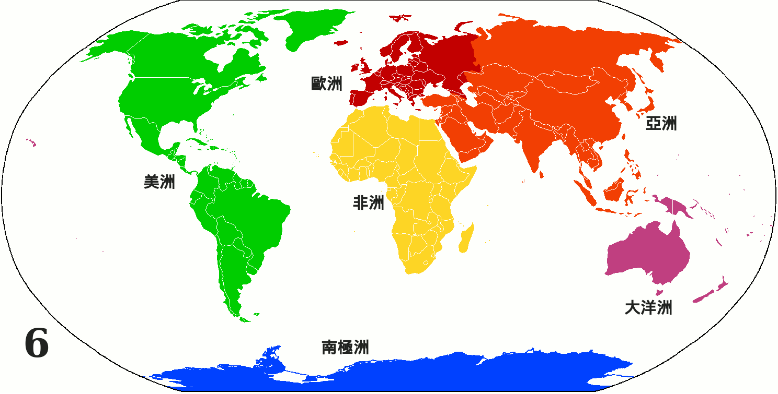
Introduction

Slide 4
Framework

Slide 5
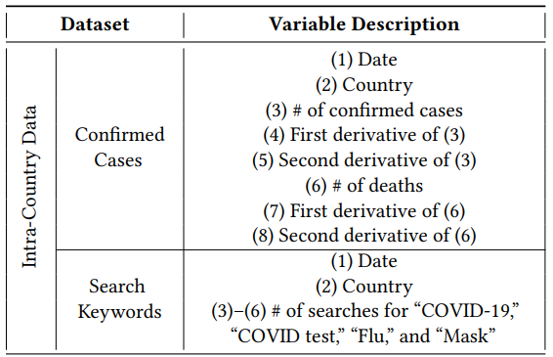
Country-Level Encoder
Input:
$X_{i}(t)$ ：epidemic statistics ；𝑖-th country 、 day 𝑡
$X_{i}(t−w+1:t)$ ：series of $X_{i}(t)$, 𝑤 is the incubation period of COVID-19.

Slide 6
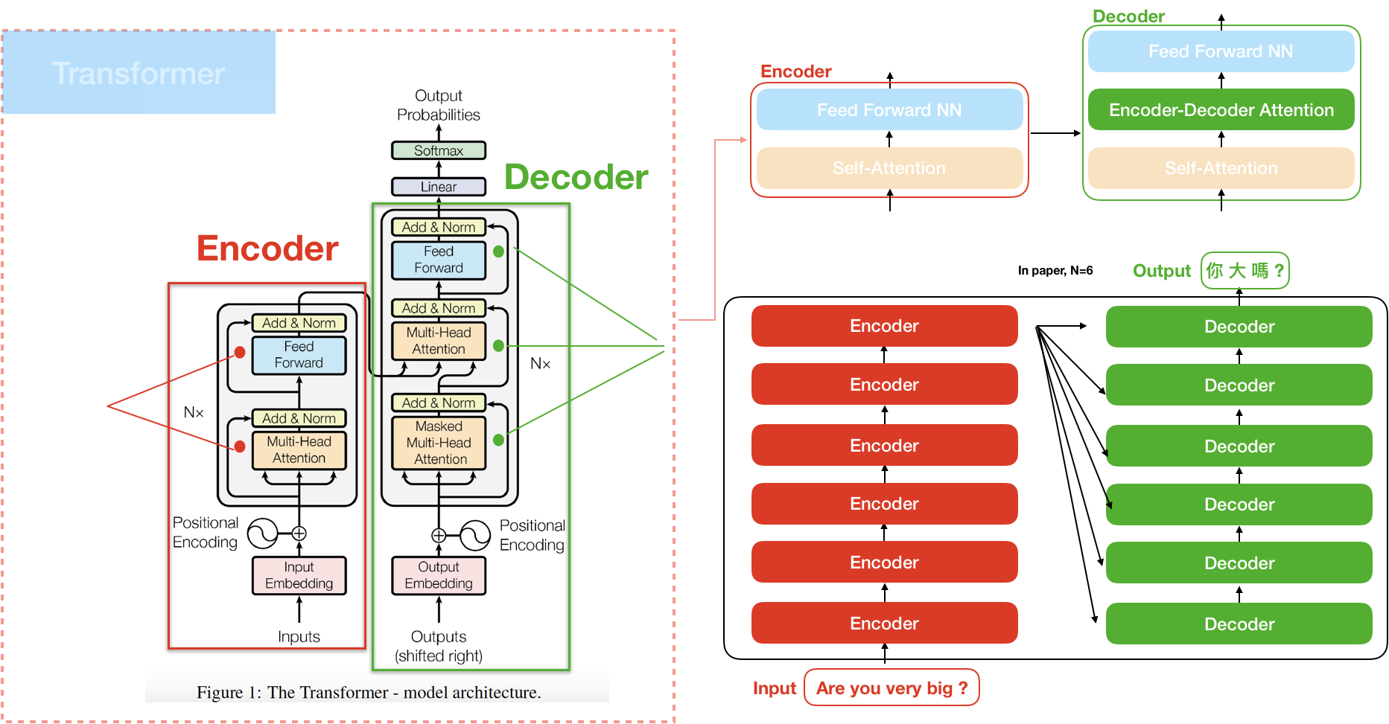

Slide 7
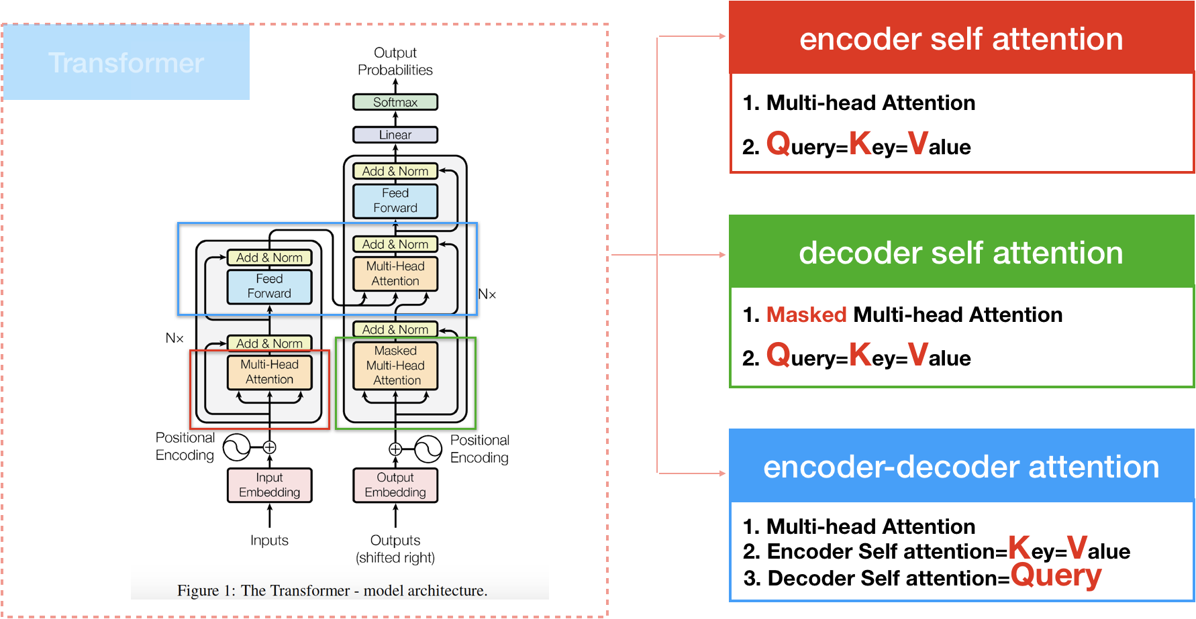

Slide 8
Notes:
Dimention 放向

Slide 9
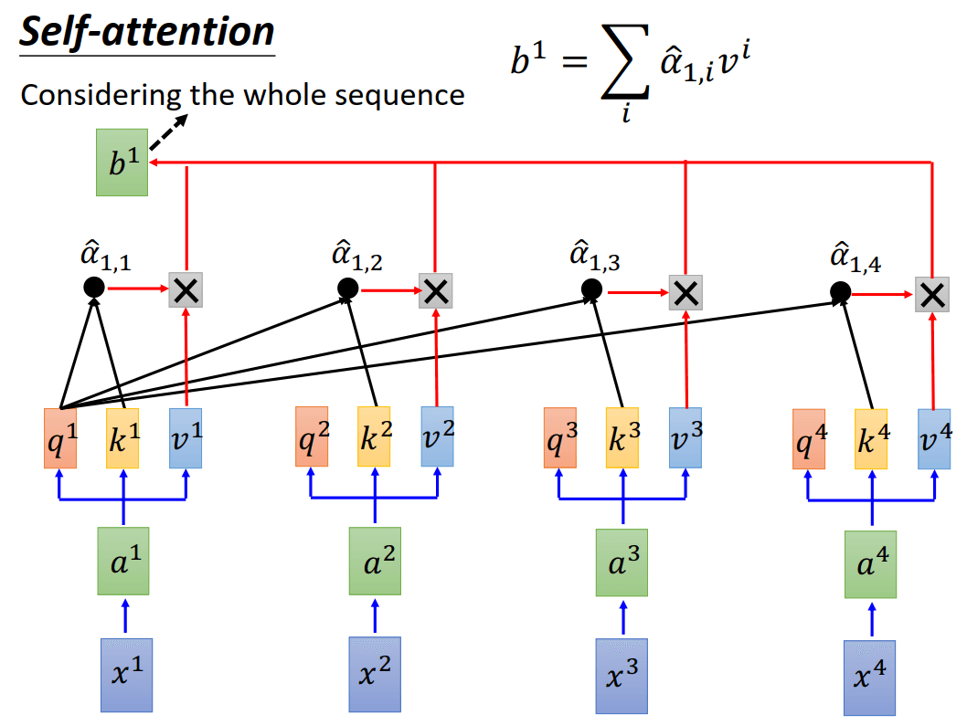

Slide 10
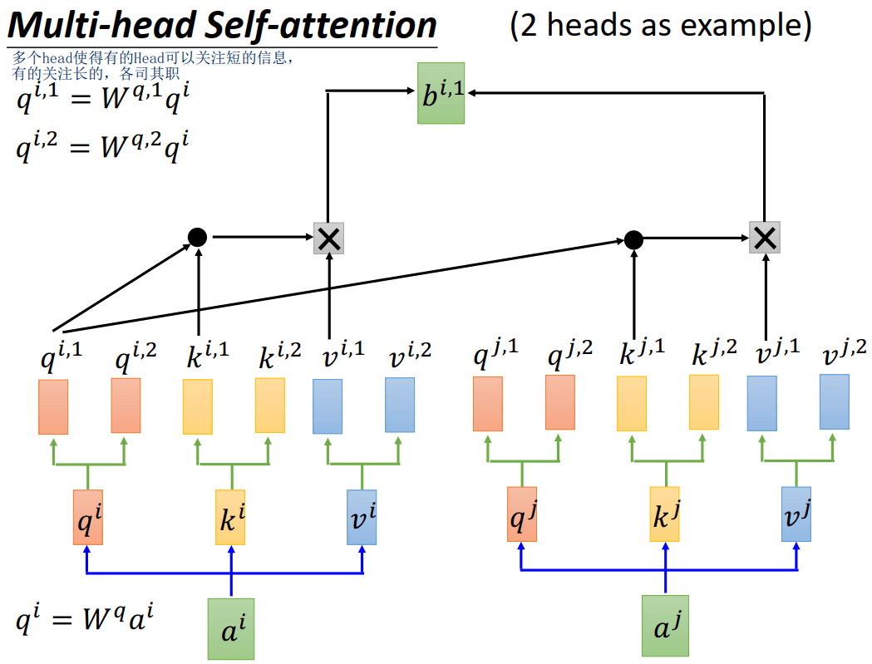
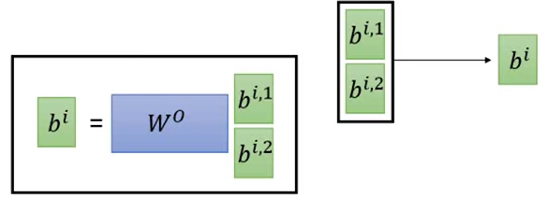

Slide 12
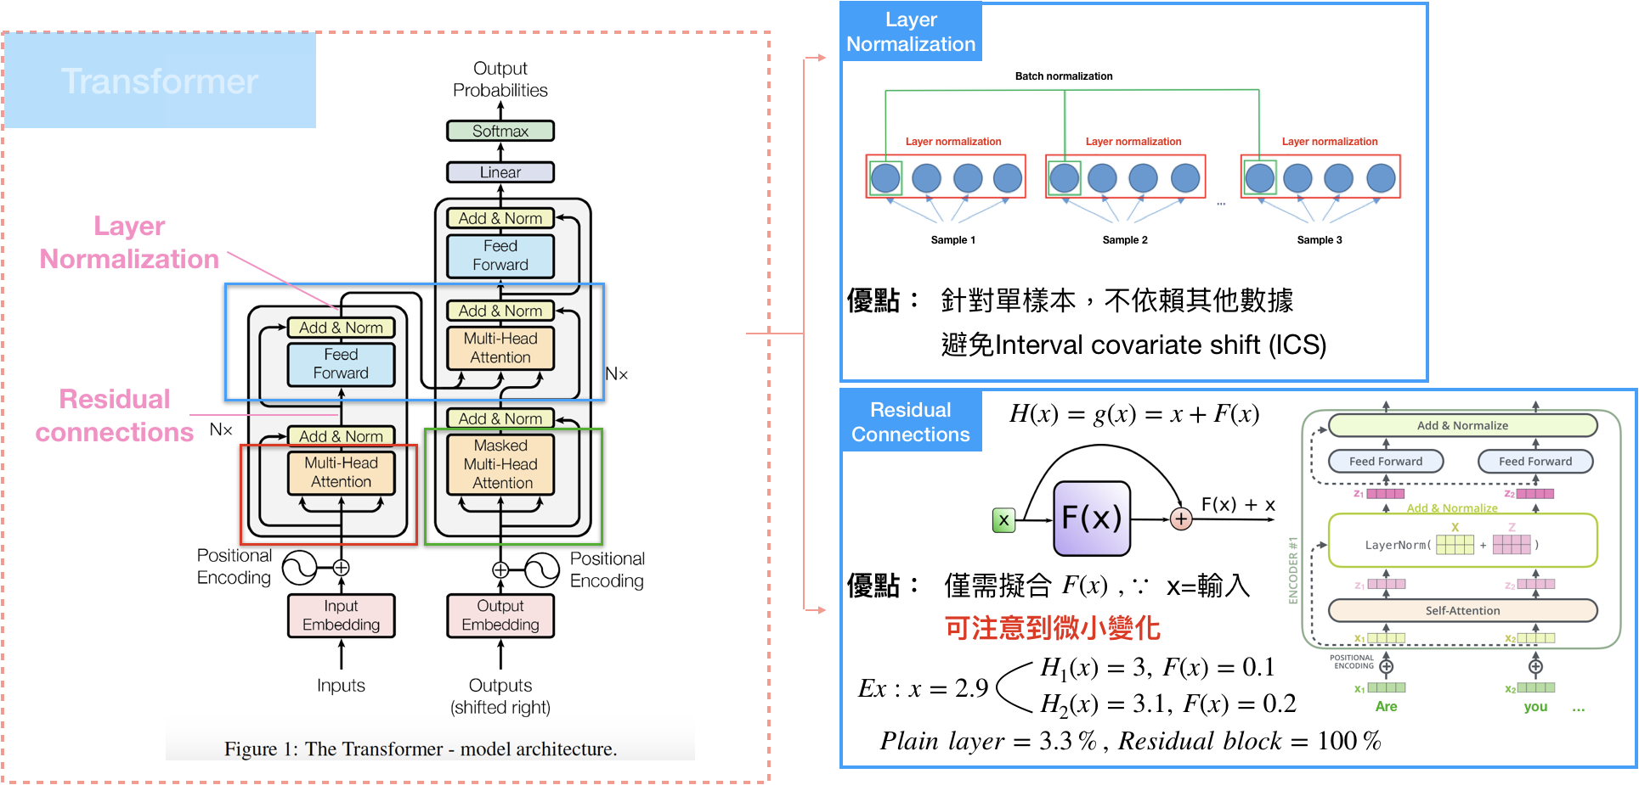
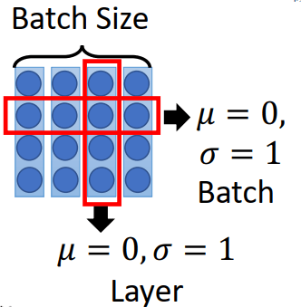

Slide 13
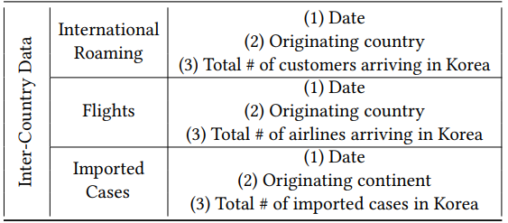
LSTM layer & Concatenate
$A_{i}(t)$ ： total inflow statistics；𝑖-th country 、 day 𝑡.

Slide 14
Continent-Level Encoder
Loss：

Slide 15
Experiment
DataSet：
Intra-Country Datasets：
Confirmed Cases：provided by Johns Hopkins COVID-19 Resource Center
keyword：collected from Google Search Trend for the four keywords
Inter-Country Datasets：
International Roaming： provided by Korea Telecom (KT)
Flights： collected from airline information system
Imported Cases ： collected by KCDC(Korea Centers for Disease Control)

Slide 16
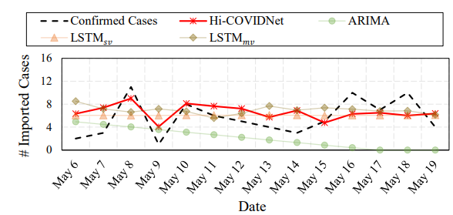
Experiment

Slide 17
Experiment

Slide 18
Conclusion
Hi-COVIDNet understands the temporal dependency of COVID-19 infections country-wise as well as the interaction from each country, followed by the incorporation of the geographic hierarchy per continent.
Hi-COVIDNet predicted the upcoming number of imported COVID-19 cases much more precisely than the baselines.

